Slide 1
Effect of Educational Attainment on per Capita Growth by State
Vicky, Adrianna, Jared, Liliya, Yousief

Slide 2

Selection of Topic
We have taken on the challenge to dissect the impact education has on per capita growth year over year on state level. The goal of our proposed question is to identify trends by state, region and/or education.
Collectively we hope to identify the indicators of monetary impact by educational attainment by state.

Slide 3


Data Source
Per Capita Income by State
Bureau of Economic Analysis: Regional Economic Accounts, Personal Income (State and Local), Annual Personal Income and Employment by State
https://apps.bea.gov/regional/downloadzip.cfm, SAINC5N_ALLAREAS_1998_2020.csv
Educational attainment
Census.gov: American Community Survey, Selected Social Characteristics in the United States,
https://data.census.gov/cedsci/table?q=DP02&g=0100000US%240400000&tid=ACSDP1Y2019.DP02

Slide 4

Questions to Answer with the Analysis
The impact education has on per capita growth year over year in each state.
Will there be notable patterns?
Are there patterns between states?
Are there patterns between regions?
Are there outliers?
If so, which state or education attainment?

Slide 5
Data Exploration
Finding Key Features was the first step:
Education Levels:
Dependent Variable/Target:
Less than 9th grade
9th to 12th grade
High School
Some College
Associate’s Degree
Bachelor’s Degree
Graduate Degree
Per Capita Income

Slide 6
Data Exploration
Pulling all data to CSV file to determine which available features were going to be used in analysis
API pull of data from census.gov website for years 2005 - 2019
API pull varied between the years 2005 - 2007 to 2008 -2019 due to website and survey reconstruction
Download and preprocessing of per capita income by state from BEA website
Preprocessing in Jupyter Notebook:
Removing columns and rows deemed unnecessary in order to read data.
Converting objects to strings
Reordering columns
Plotting data to help determine the patterns to dive in deeper

Slide 7
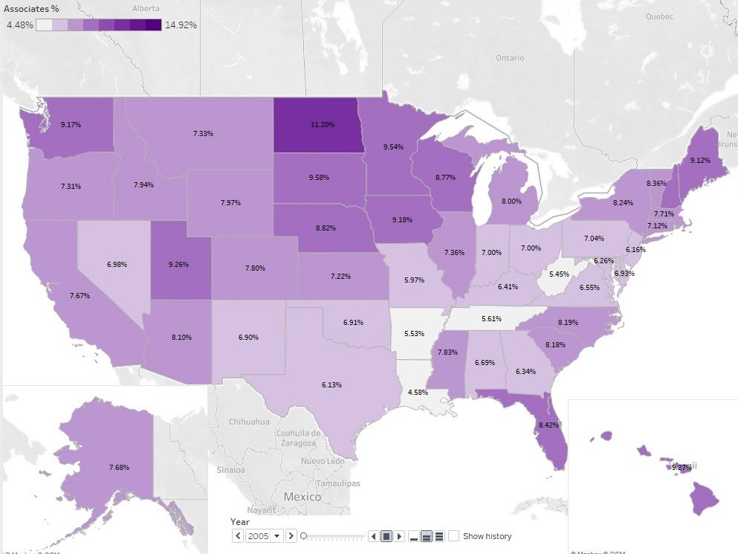
Data Visualization - Tableau
https://public.tableau.com/app/profile/vicky.carlson/viz/EffectofEducationalAttainmentonPerCapitaIncomeGrowth/Story1

Slide 8
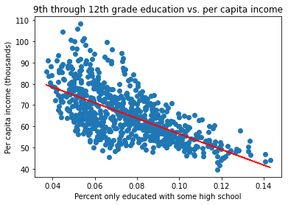
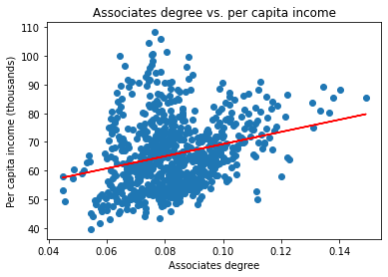
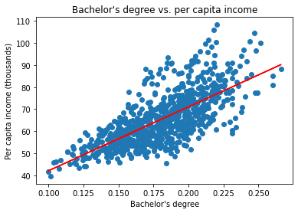
Analysis - Linear Regression
A positive and negative linear regression relationship is observed when categorized by the type of educational attainment.
Overall, higher levels of education was associated with higher incomes
From the linear regression we were able to attain below metrics:
R2
Coefficients
Intercept

Slide 9
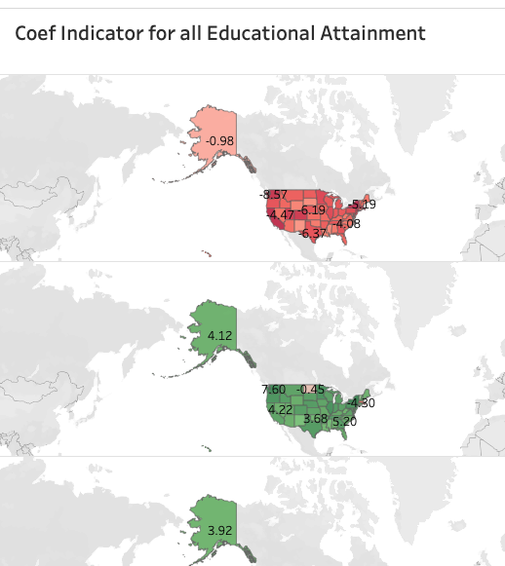
Data Visualization - Tableau
https://public.tableau.com/app/profile/yousief.beyene/viz/CoefIndicatorofalleducationalattainments/Sheet1

Slide 10

Analysis - Machine Learning
SKLearn Linear regression model measured the association between seven levels of educational attainment and income
Random Forest model mapped the relative importance of each feature in predicting income

Slide 11
Analysis - Machine Learning
Linear regression model does not accounts for all variance (R2 = .67)
Coefficients in the linear regression model indicate the direction of association
Random Forest model has very high predictive capacity (R2 = .86)
Random Forest is non-linear and can’t describe impact directionality
Importances in the RF model shows how much each feature matters
Combining the two metrics uses the best of both models

Slide 12
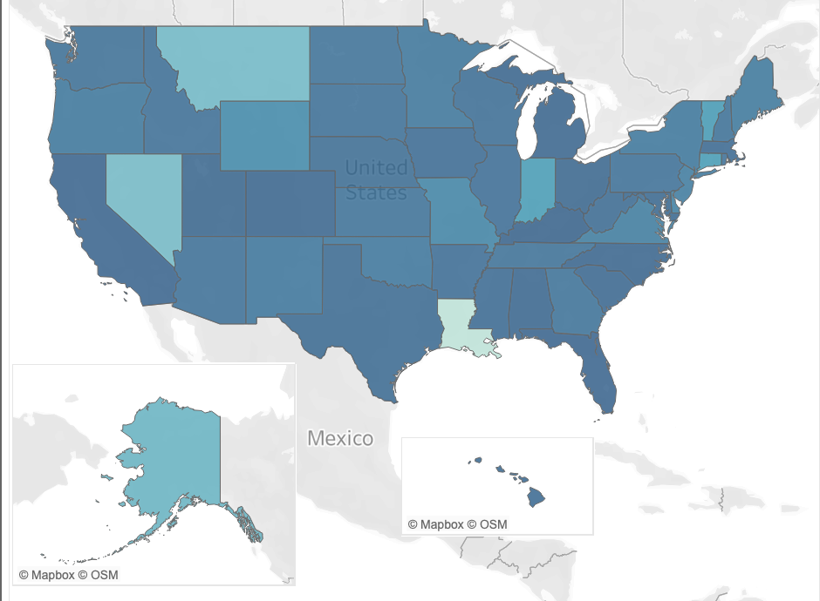
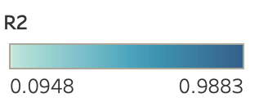
Analysis - Machine Learning

Slide 13
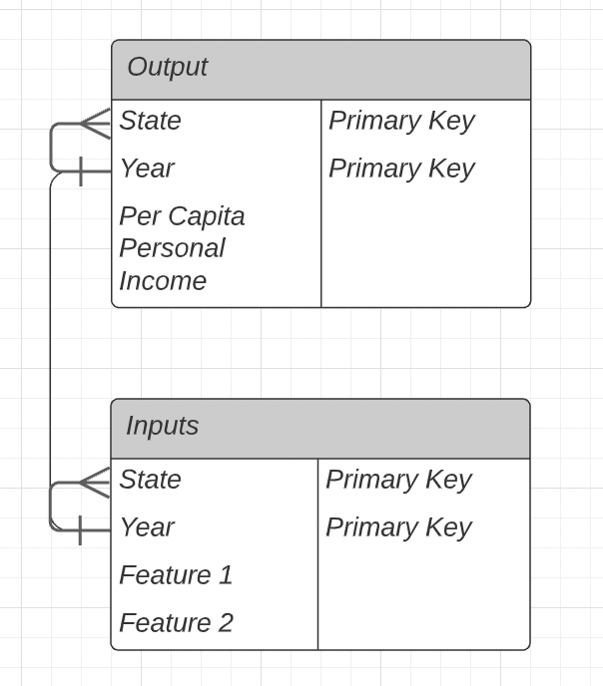

Databases
Two tables:
Input
Output
Machine Learning Results

Slide 14
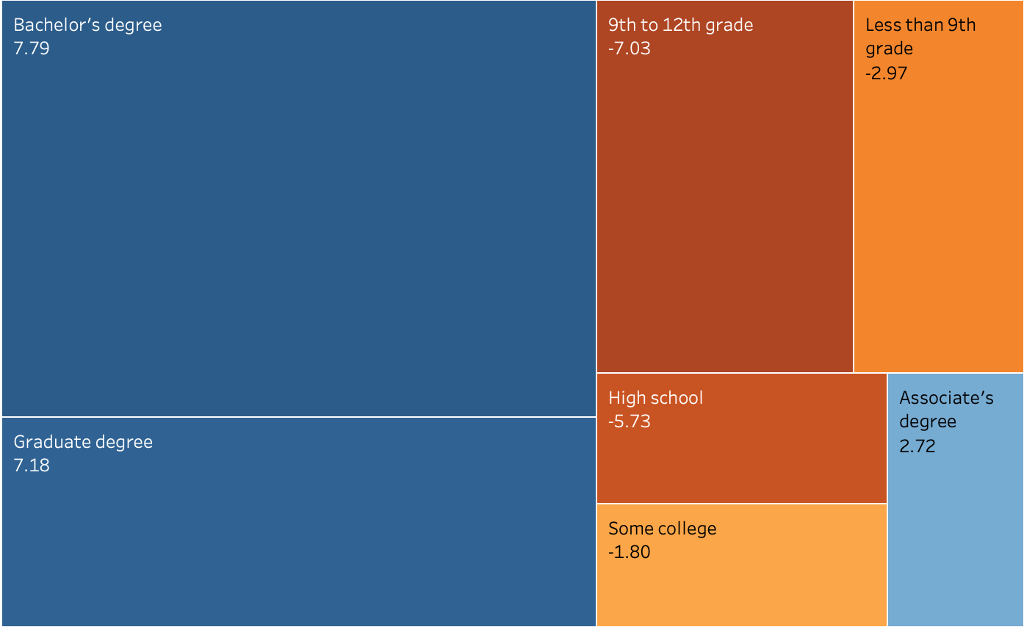
Result of Analysis
There was a clear direction for our model and for each educational attainment level.
9th-12th grade, Bachelor’s degree and Graduate degrees had the greatest relative importance influence on per capita income.
Model that was created is robust!

Slide 15

Recommendation for Future Analysis
Zone in on the why behind the outliers such as Montana, Louisiana, Alaska & Nevada.
Additional factors, such as gender, race, age and migrant population and analyze their impact.
Expand Machine Learning Model.
Identify primary industries in each state and patterns they create.

Slide 16
Anything That Would Be Done Differently
Dive in deeper into the data and trends identified.
Structure output in Jupyter notebook as CSV instead of JSON.
Analyze more data, going further back historically.
Connect API calls to database

Slide 17
Technologies, Languages, Tools and Libraries
Python 3.7.11
Pandas 1.3.5
Requests 2.26.0
Census Data 1.15
Pathlib 2.3.6
Matplotlib 3.5.0
Sklearn 1.0
Jupyter 1.0
pgAdmin 5.7
PostgreSQL
Tableau Desktop 20.4.2
Tableau Public
Microsoft Excel
Google Drive, Docs, Slides

